Slide 1
AI-powered Quality control in Bioprocessing: automation of CRO test with Computer Vision
02216822 Subin Hyun (BA2)

Slide 2
Index
Introduction
Keywords
Why automation of QC in bioprocessing required?
What are some advantages of CV application in QC?
Method
Result
Conclusion & Discussion

Slide 3
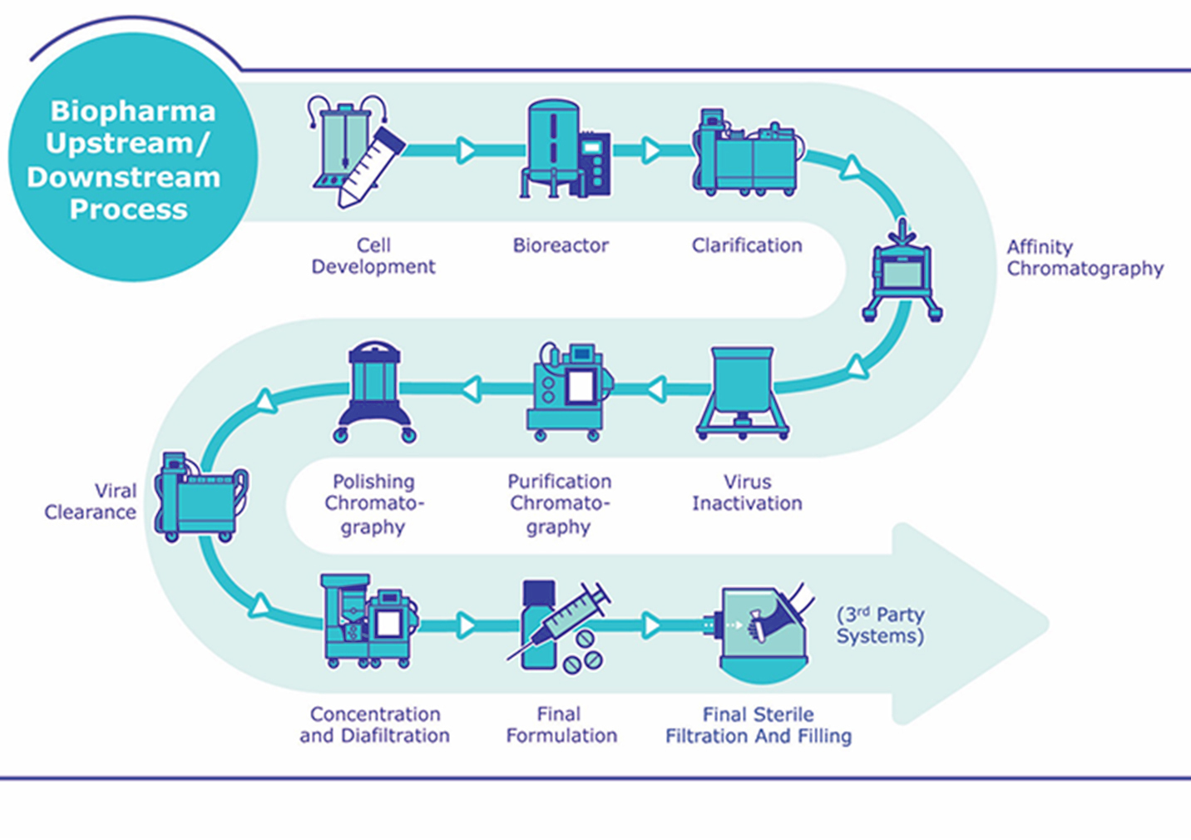
Introduction-Keywords
Bioprocessing
Source: Pharma’s almanac, Factory of the Future Will Be a Convergence of Digital and Bioprocessing Technologies

Slide 4
Introduction-Keywords
Quality Control (QC)
Cell Retention Optimization (CRO) test
Compliance
Risk Mitigation
Consistency
Cell viability
Cell density
Retention Efficiency
Productivity
Source: ISO 9001:2015 - International standard for Quality Management Systems
Wang, Y., et al. (2016). "Optimization of perfusion bioreactor systems for large-scale cell culture applications in biotechnology." Biotechnology and Bioengineering, 113(8), 1801-1811.

Slide 5
Introduction-Why automation of QC required?
Reduce cost & time
Follow up overall process
Real-time monitoring
Consistency & Scalability
Efficiency & Accuracy
Minimized Destructive Testing (DT)

Slide 6
FDA regulations for CRO test
USP <61> : quantitative testing of microbiome
USP <62> : assuring absence of specified harmful microorganisms
Staphylococcus aureus
Pseudomonas aeruginosa
Escherichia coli
Salmonella species
Candida albicans
Bile-tolerant Gram-negative bacteria
For “sterilized” pharmaceuticals CRO test

Slide 7
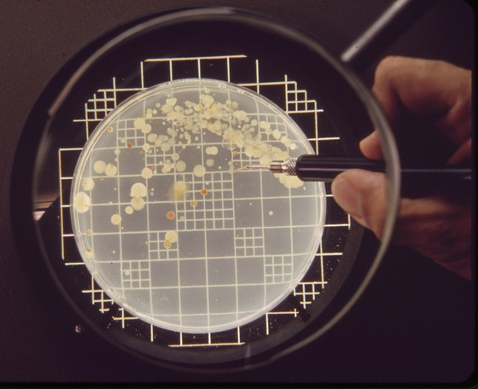
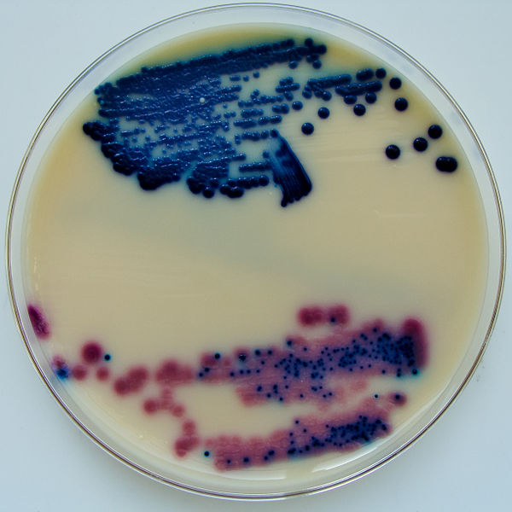
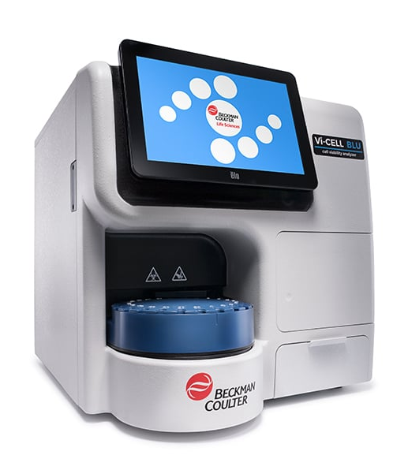
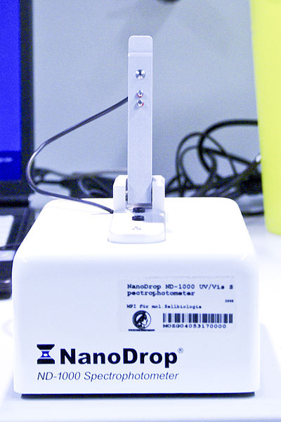
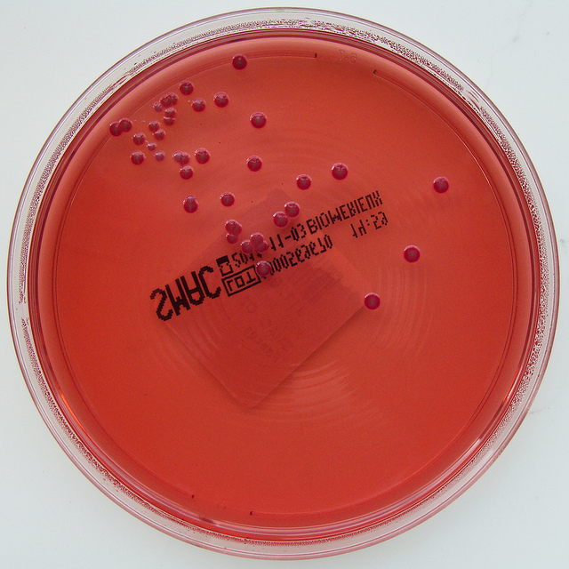
Main Idea: automation of counting micro-organisms
Direct counting | vs | Indirect counting
Pros + Accurate counting can be done |  | Pros + Not much human work
+ dead cells can be ignored while counting |  | + Timely efficient
Cons |  | Cons
- Human error can occur |  | - Cannot distinguish living/dead cells
- Cost/Timely inefficient |  | - Only estimation can be done

Slide 8
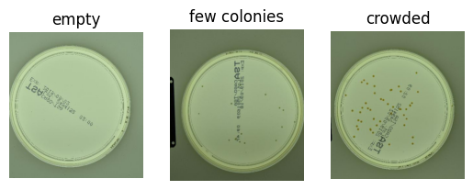
Model training-dataset selection
annotated dataset for colony unit count of micro-organisms

Slide 9
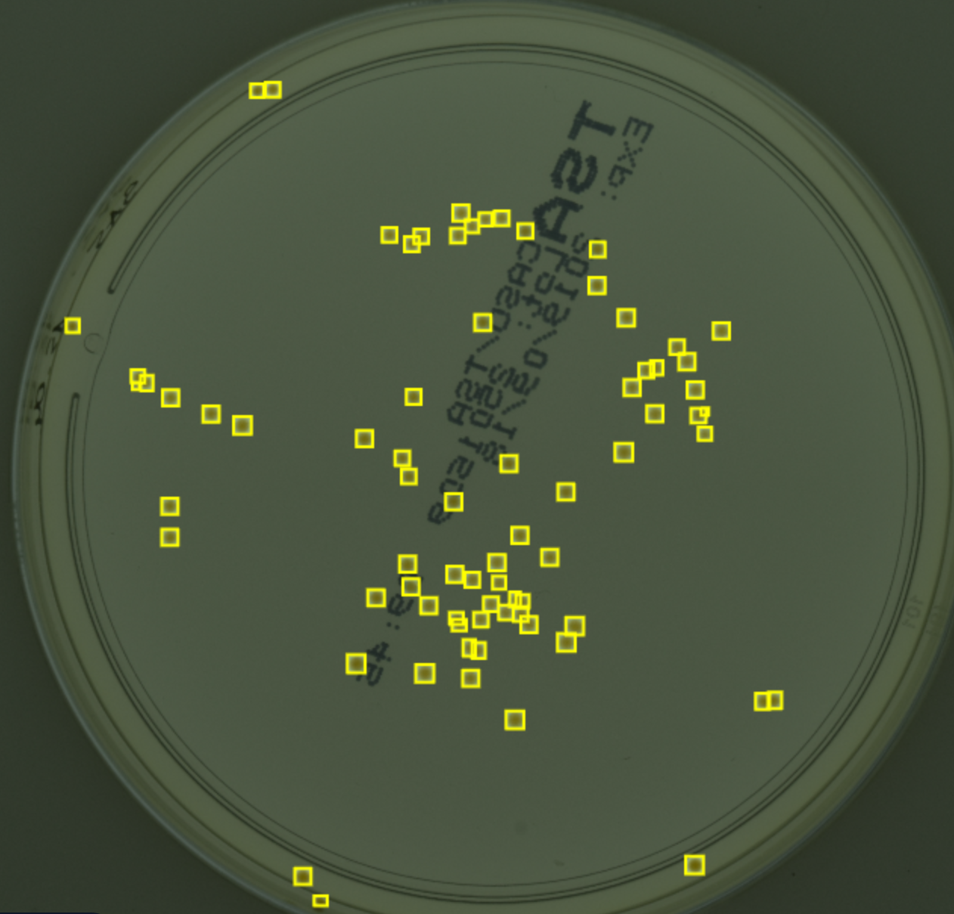
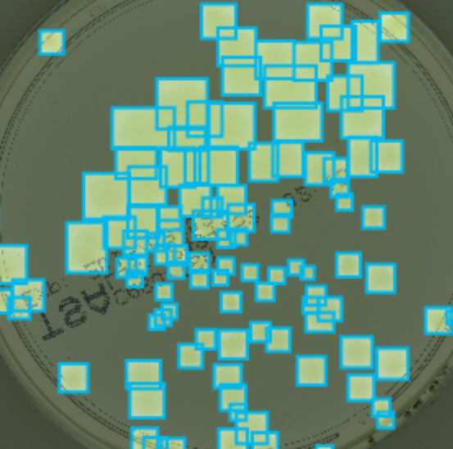
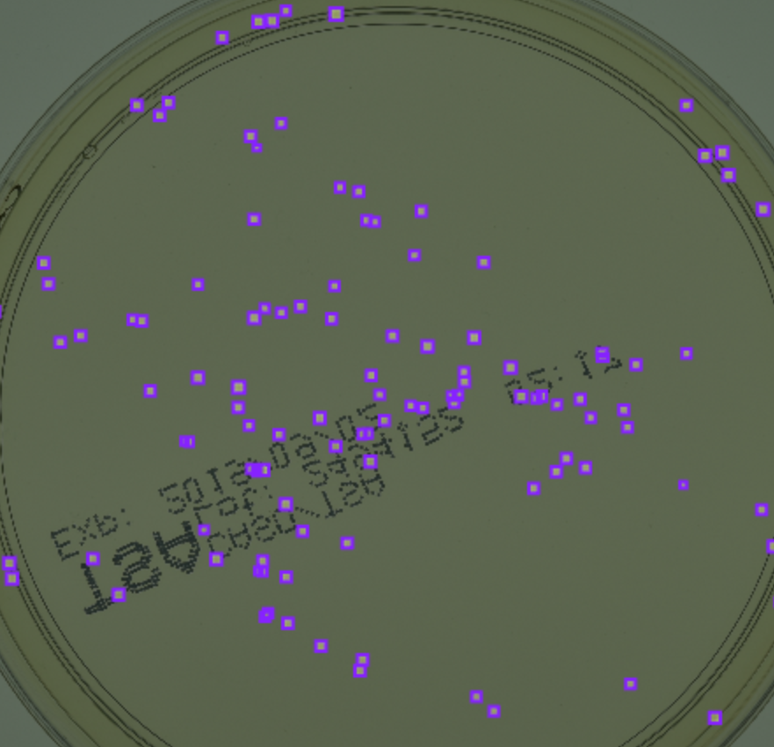
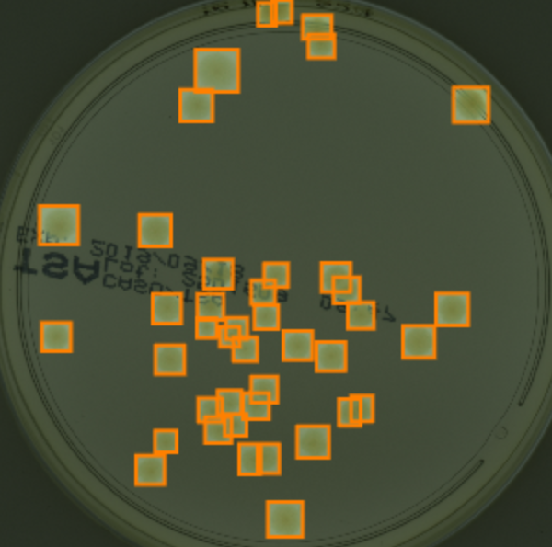
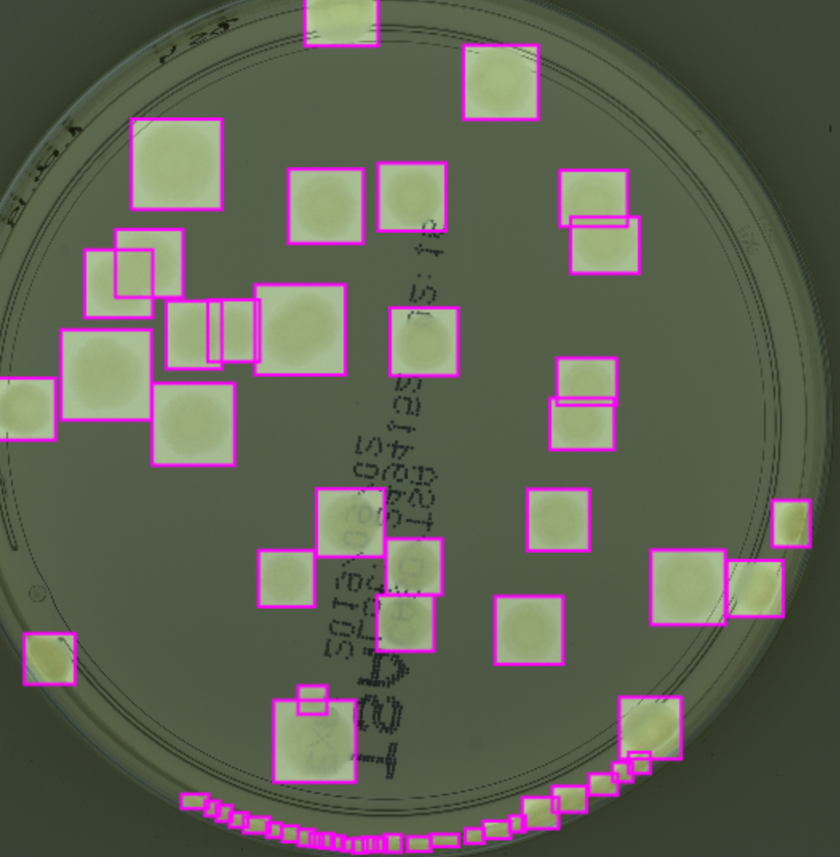
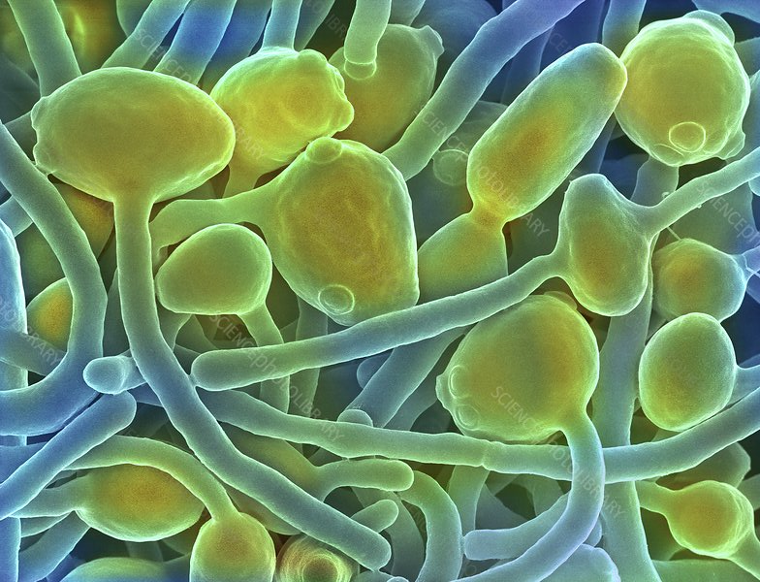
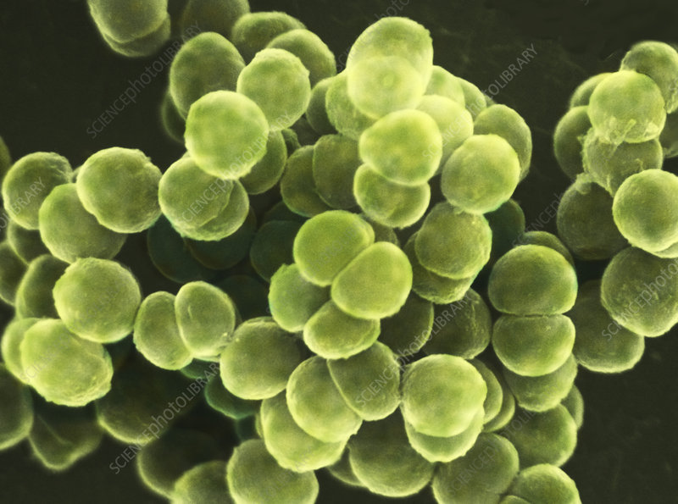
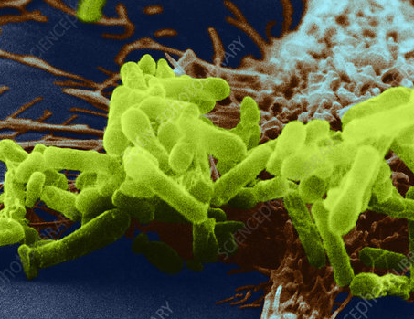
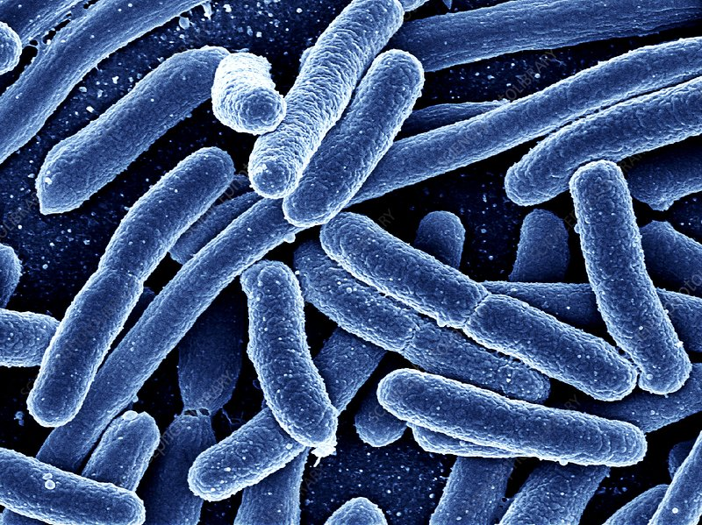
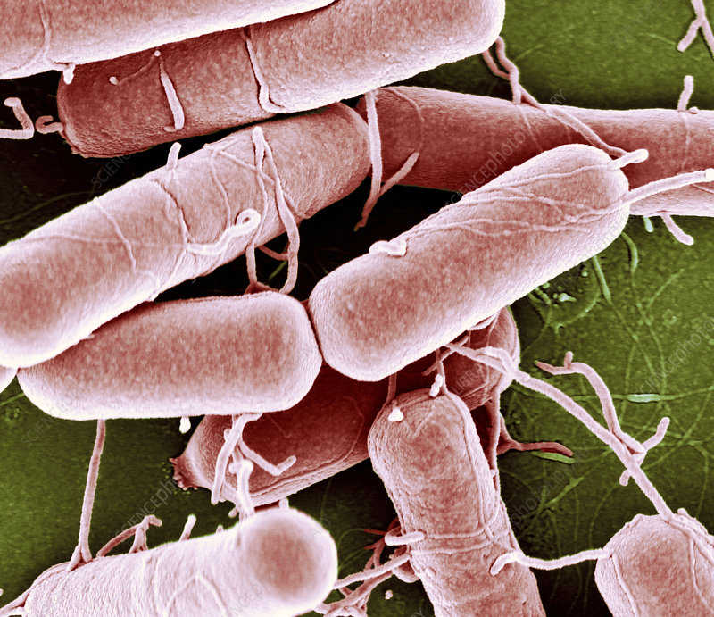
Model training-annotated data
Staphylococcus aureus Pseudomonas aeruginosa Escherichia coli Candida albicans Gram-negative
bacteria
Image source: Science photo library

Slide 10
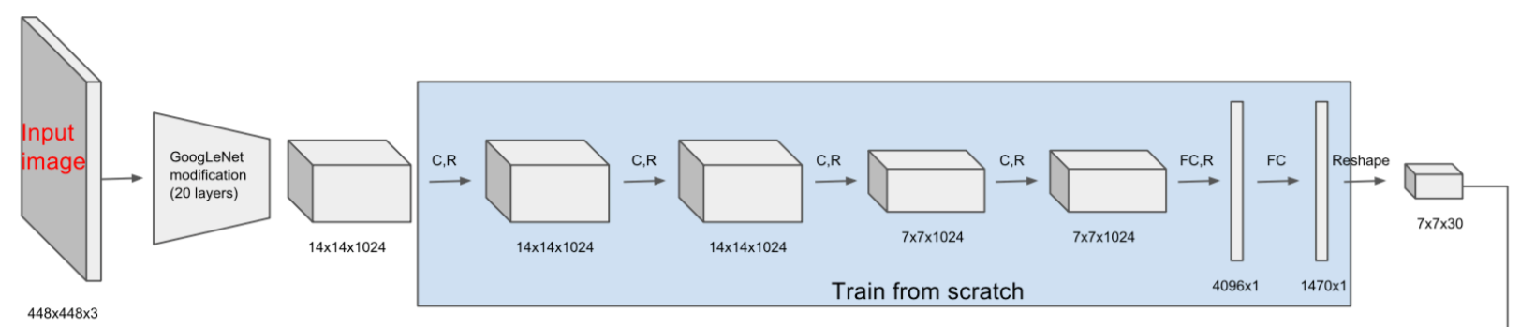
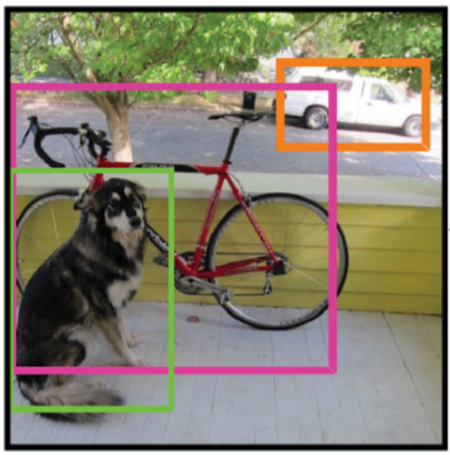
Model training-model type selection
Yolo models: one step object detection (you only look once)
For long term view, yolo models can work for real time object detection
rt-detection is required for the automation of the quality control in “bioprocess”

Slide 11
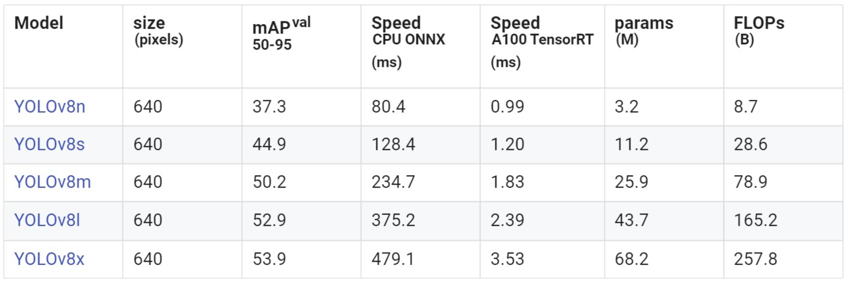
Model training-yolo version selection

Slide 12
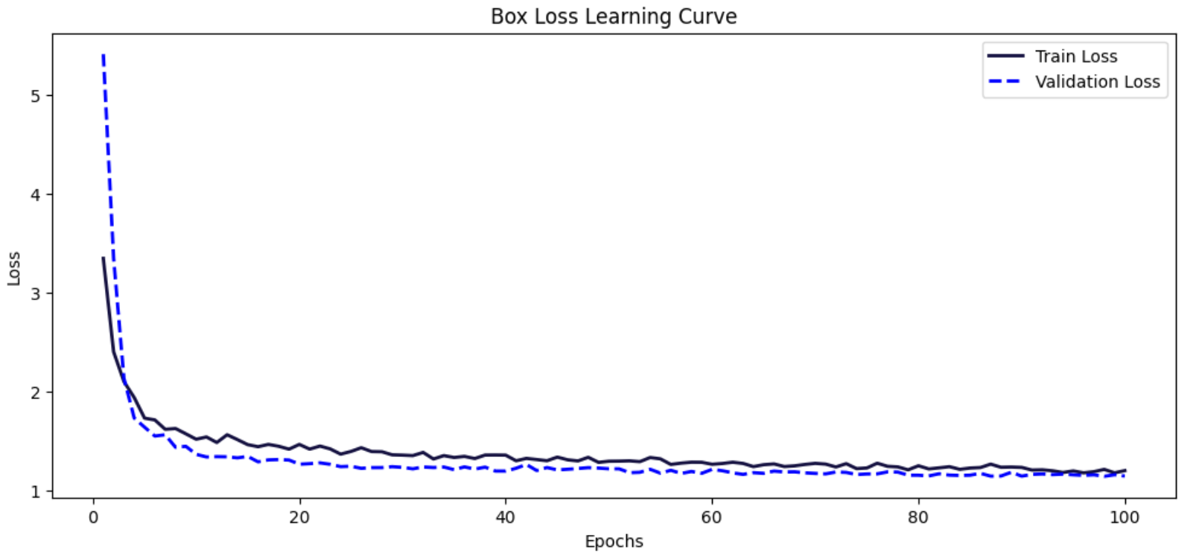
Model training-loss trend graph: Box loss

Slide 13
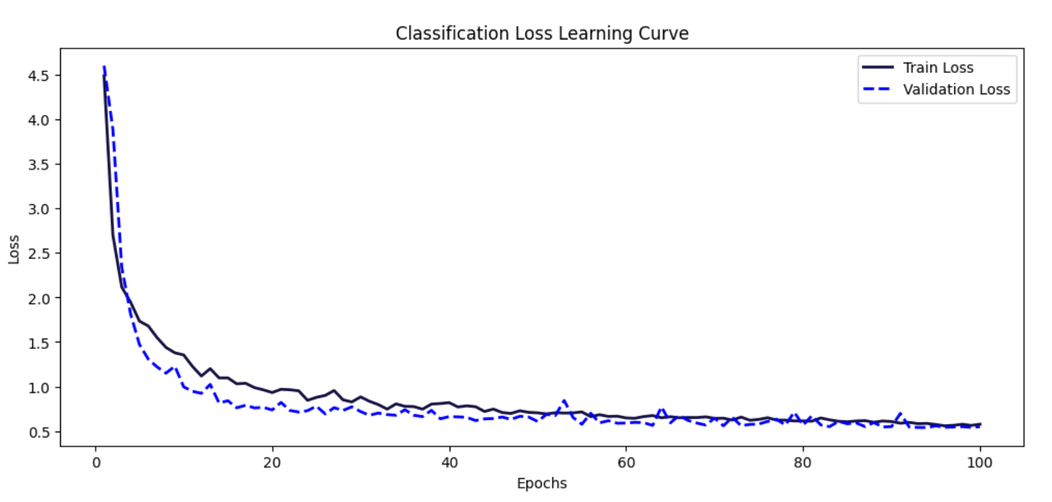
Model training-loss trend graph: Classification loss

Slide 14
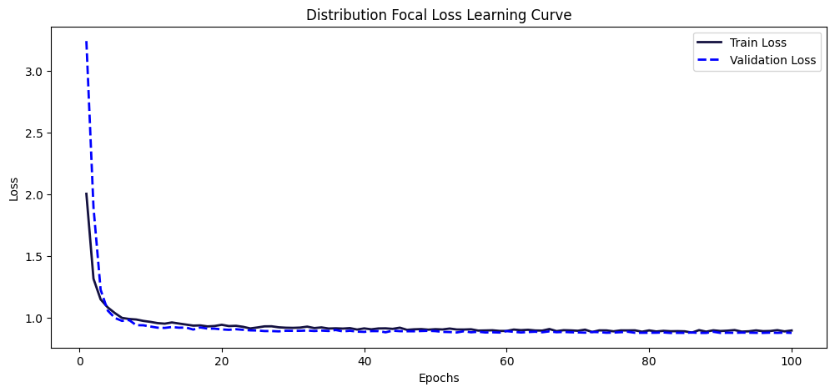
Model training-loss trend graph: distribution focal loss

Slide 15
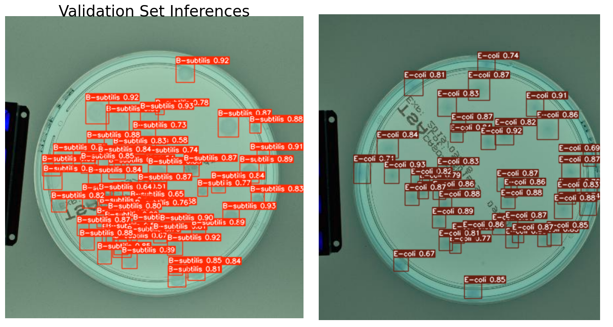
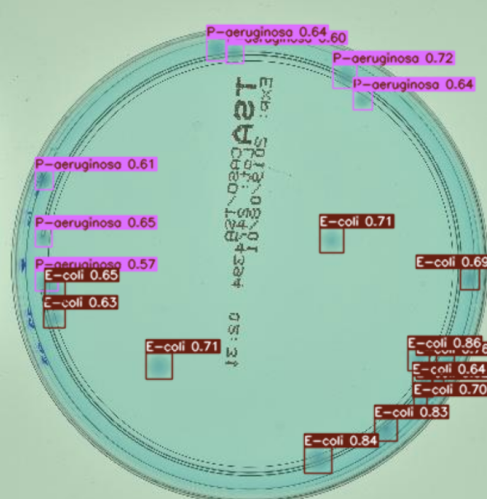
Model training-validation

Slide 16
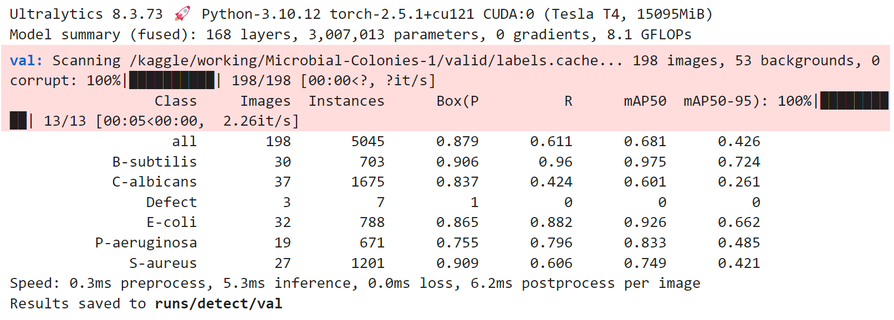
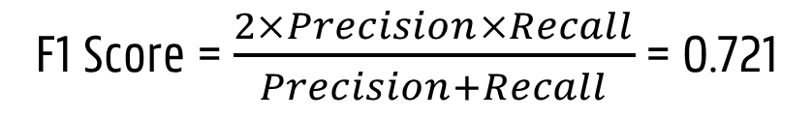
Model training-validation
 | Metric Value
metrics/precision(B) | 0.879
metrics/recall(B) | 0.611
metrics/mAP50(B) | 0.681
metrics/mAP50-95(B) | 0.426
fitness | 0.451
F1 Score = $\frac{2×Precision×Recall}{Precision+Recall}$ = 0.721

Slide 17
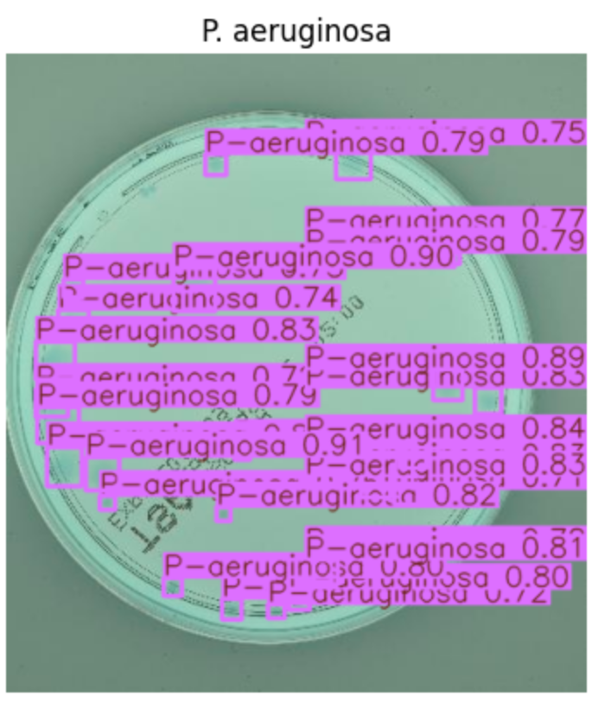
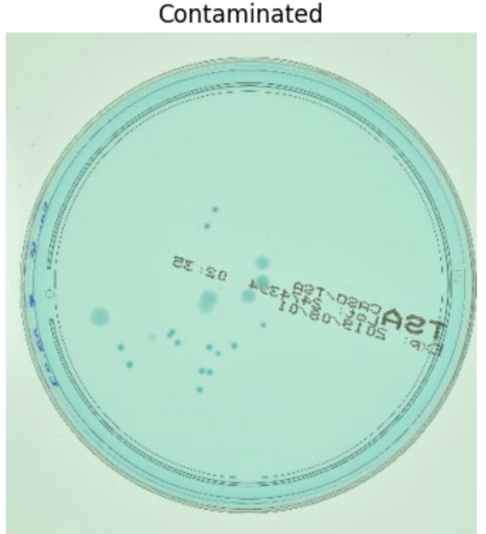
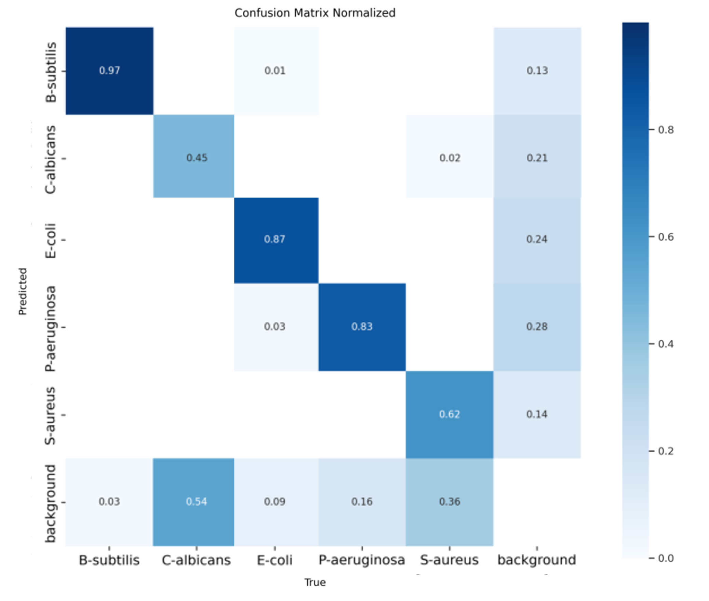
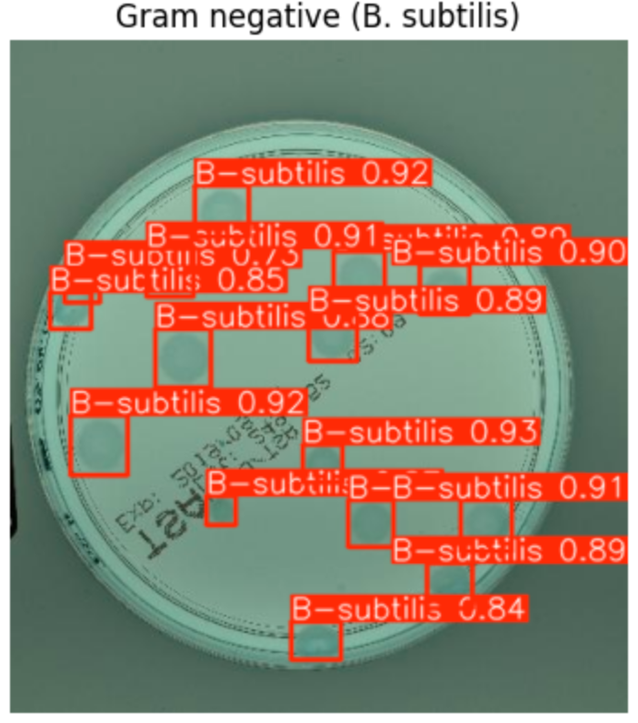
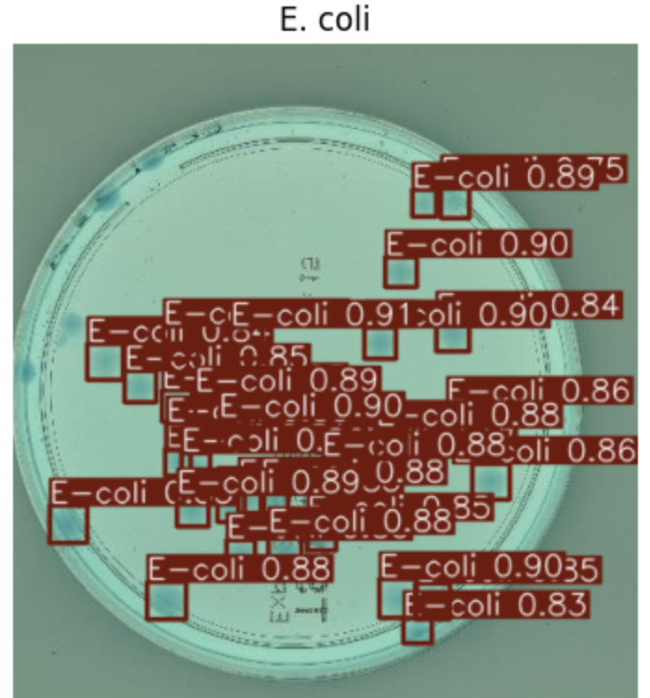
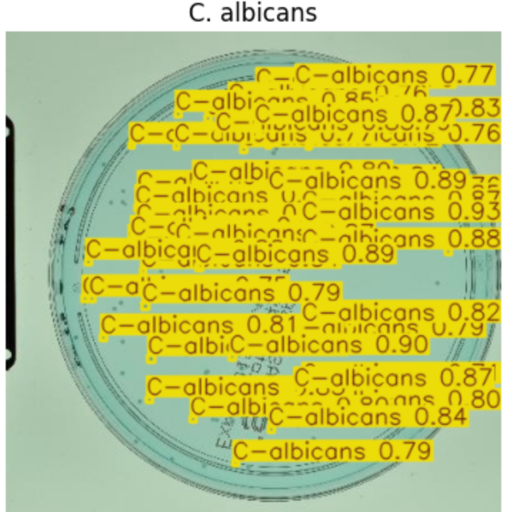
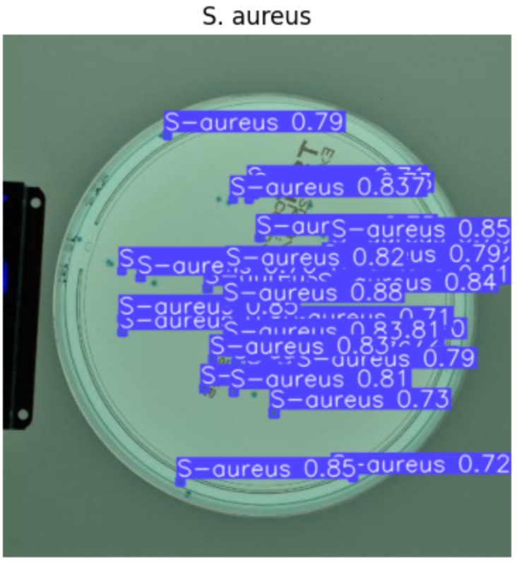
Model evaluation

Slide 18
Result
Fine-tuned yolov8 model is good at classification and recognizing the region for 5 main micro-organisms regulated in FDA pharmaceutical regulation
Some colonies were not detected (-> low recall)
No detection for contamination

Slide 19
Model evaluation-test metric values (not augmented)
Epoch # | Second fine-tune | Second fine-tune epoch # | Precision | Recall | F1 score | human eval
50 | No | . | 0.770 | 0.566 | 0.652 | medium
50 | Yes | 100 | 0.660 | 0.742 | 0.699 | low
100 | No | . | 0.879 | 0.611 | 0.721 | high
150 | No | . | 0.957 | 0.593 | 0.732 | high
200 | No | . | 0.955 | 0.602 | 0.738 | high
200 | Yes | 100 | 0.794 | 0.675 | 0.730 | low

Slide 20
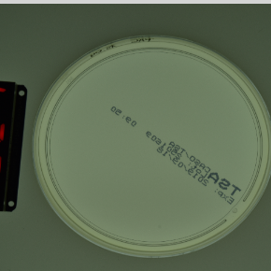
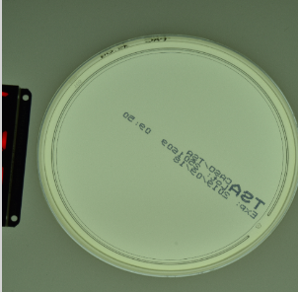
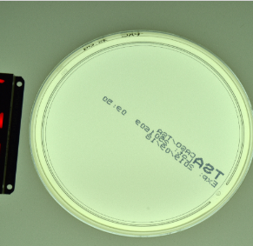
Model improvement-data augmentation
-25% brightness
Original image
+25% brightness

Slide 21
Model improvement-test metric values (augmented)
Data augmentation | Epoch # | Precision | Recall | F1 score
Yes | 50 | 0.810 | 0.591 | 0.683
Yes | 100 | 0.815 | 0.601 | 0.692
Yes | 150 | 0.818 | 0.654 | 0.727
Yes | 200 | 0.849 | 0.646 | 0.734
Yes | 300 | 0.808 | 0.664 | 0.729
Yes | 600 | 0.816 | 0.639 | 0.717

Slide 22
Model improvement-test metric values (augmented)
Data augmentation | Epoch # | Precision | Recall | F1 score
Yes | 50 | 0.810 | 0.591 | 0.683
Yes | 100 | 0.815 | 0.601 | 0.692
Yes | 150 | 0.818 | 0.654 | 0.727
Yes | 200 | 0.849 | 0.646 | 0.734
Yes | 300 | 0.808 | 0.664 | 0.729
Yes | 600 | 0.816 | 0.639 | 0.717
Yes | 200 | 0.796 | 0.694 | 0.741

Slide 23
Conclusion
The best number of epoch is 200 both for not augmented model and the augmented model.
When preprocessing and augmentation technique is applied to the dataset, the model gets better precision than the same epoch finetuned one.
If use the model as pretrained model and train with another petri-dish dataset (the ones that multiple labels are on one petri dish), the F1 score gets higher but the actual inferences show poor performances.
If apply the precision and recall from test dataset, the ones that are retrained get lower F1 score.

Slide 24
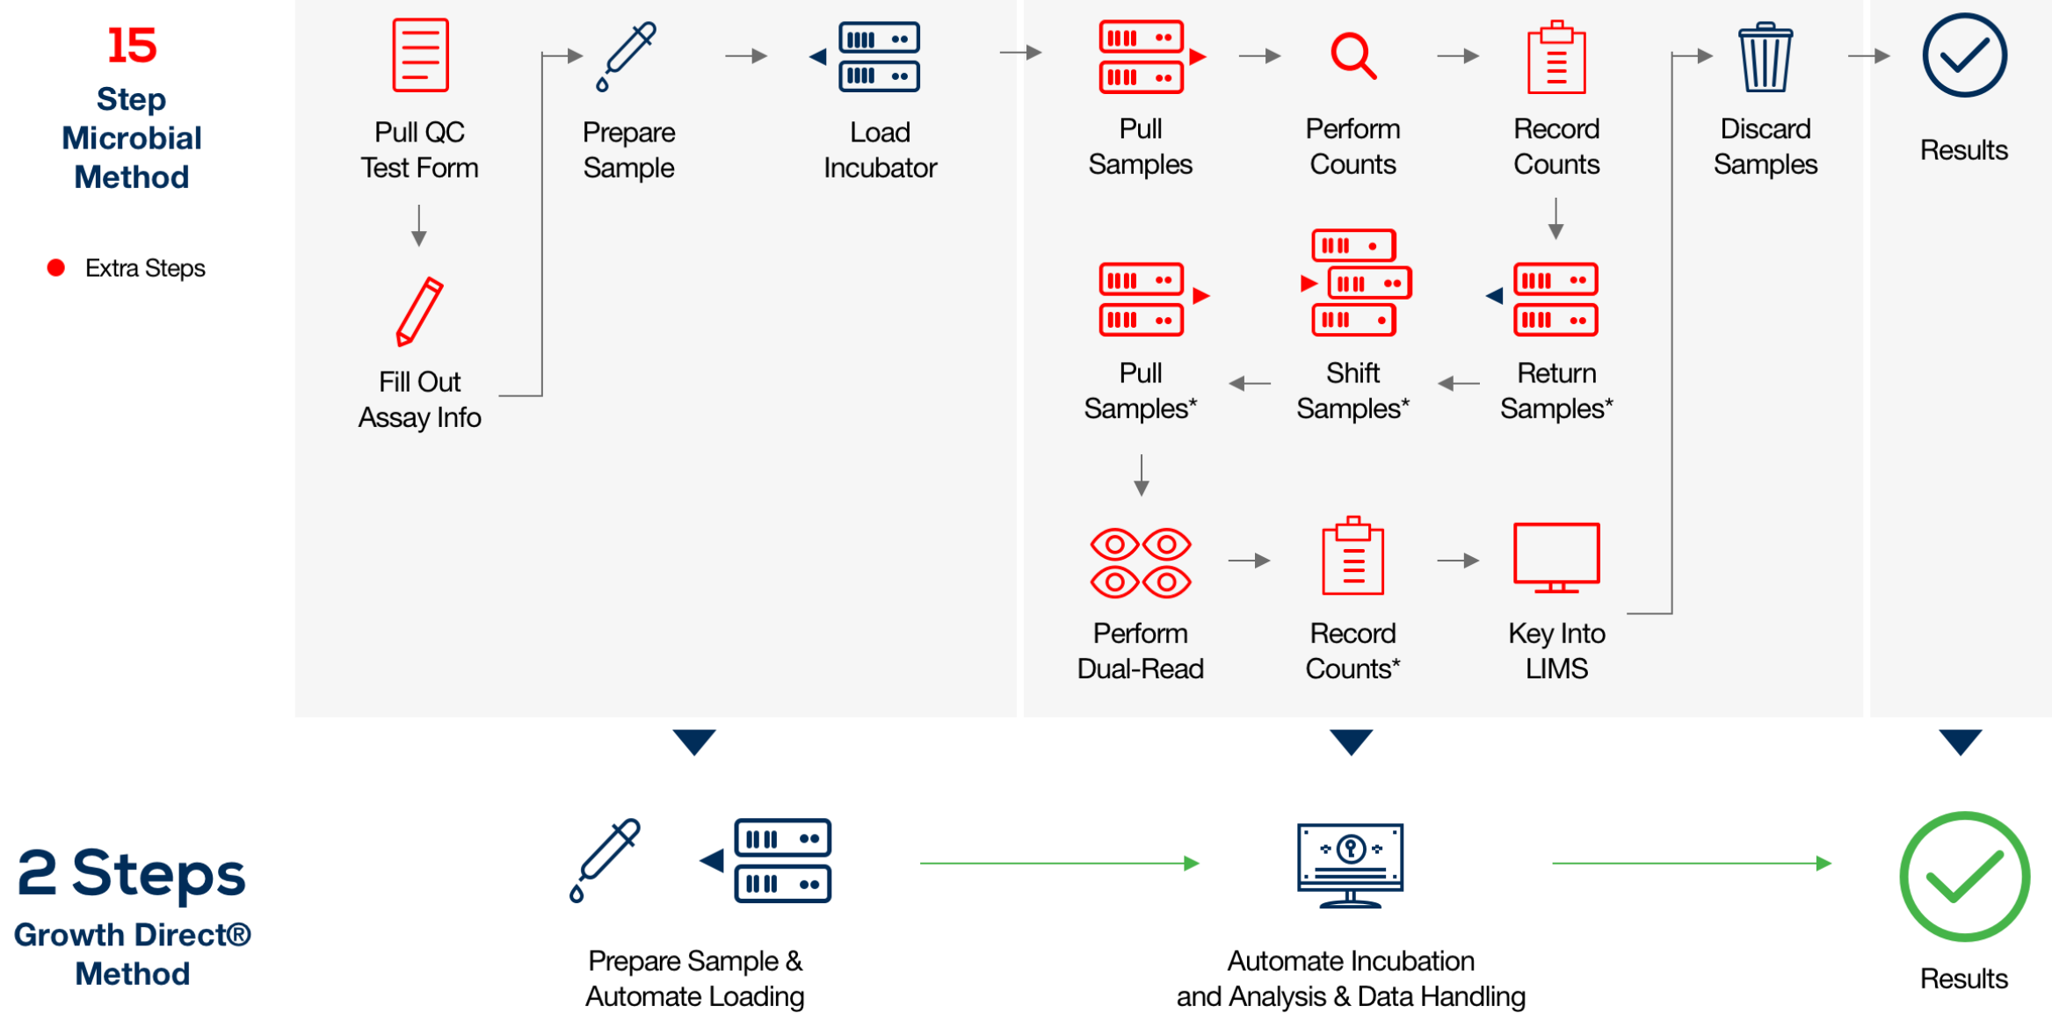
Industrial use : Growth Direct® System

Slide 25
Discussion: Gained Knowledge & Experiences
Object detection (two stage models, one stage models)
Computer vision techniques
Micro-organism image dataset labeling
Industrial usage of computer vision in bioprocessing
FDA standards for pharmaceutics’ development & quality control
Yolo model development history
Yolo model finetune & evaluation
Augmentation techniques and the actual applications

Slide 26
Discussion: Further study ideas
Real-time detective model training for rt-QC in bioprocessing using video
Wider labels of microorganisms (varying microorganisms for the detection)
SSD (single shot multibox detector) usage in bioprocessing QC
Transformer usage in object detection (DETR: detection with transformer)
Evaluating model usage on microorganism classification/detection
Microorganism detection in oral/colon/stomach epithelial cells
Diagnostics from urine sample; microorganism classification using CV
Biomedical paper analysis using BioBERT (another pretrained model)
Model training for laboratory usage (creation of pretrained model for biolab)
Augmentation technique that fits to the model of micro-organism detection

Slide 27
References (1)
Bacteria. (2022, September). Microbial Colonies Dataset [Open Source Dataset]. Roboflow Universe. Roboflow. Retrieved February 1, 2025, from https://universe.roboflow.com/bacteria-5xdkl/microbial-colonies
Farzadnekouei. (2024, January 7). Real-Time Traffic Density Estimation with YOLOv8. Kaggle. https://www.kaggle.com/code/farzadnekouei/real-time-traffic-density-estimation-with-yolov8/notebook
FDA. (25 Aug 2020). Pharmaceutical Microbiology Manual. FOOD AND DRUG ADMINISTRATION OFFICE OF REGULATORY AFFAIRS Office of Regulatory Science, 7(2), 1-92.
Jarostaw, P., Sylwia, M. (13 Oct 2021). Recognition and counting of microorganisms on Petri dishes. https://neurosys.com/blog/recognition-and-counting-of-microorganisms
J. Redmon et al. YOLO9000: Better, Faster, Stronger. arXiv 1612.08242
J. Redmon et al. YOLOv3: An Incremental Improvement. arXiv 1804.02767
Rodrigues, P. M., Luís, J., & Tavaria, F. K. (2022). Image analysis semi-automatic system for colony-forming-unit counting. Bioengineering, 9(7), Article 271. https://doi.org/10.3390/bioengineering9070271

Slide 28
References (2)
Redmond et al. (2015). You Only Look Once: Unified, Real-Time Object Detection, CVPR
Rodrigues, P. M. (Creator), Luis, J. (Creator), Tavaria, F. (Creator) (21 Jun 2022). Petri dishes digital images dataset of e.coli, s.aureus and p.aeruginosa. Figshare. 10.6084/m9.figshare.20109377.v2
Ross et al. (2014). Rich feature hierarchies for accurate object detection and semantic segmentation.
Stanford 231b, selective search, http://vision.stanford.edu/teaching/cs231b_spring1415/slides/ssearch_schuyler.pdf
Stpete_ishii. (2022). Micro Organism Classify MONAI Pytorch, Version 10.
Ultralytics. (2024, December 18). Tips for model training. Tips for model training - Ultralytics YOLO docs. https://docs.ultralytics.com/ko/guides/model-training-tips/
Wang, Y., et al. (2016). "Optimization of perfusion bioreactor systems for large-scale cell culture applications in biotechnology." Biotechnology and Bioengineering, 113(8), 1801-1811.
Yolov8 vs. EfficientNet. Compared and Contrasted. (n.d.). https://roboflow.com/compare/yolov8-vs-efficientnet

Slide 29
Thank you. Any Questions?
AI-powered Quality control in Bioprocessing: automation of CRO test with Computer Vision
02216822 Subin Hyun

